Slide 1
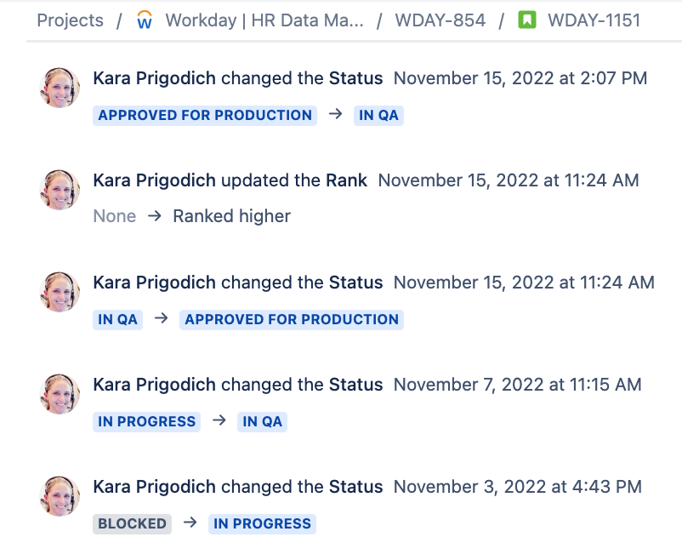
Example 0: Prioritization of Work
Added December 27, 2022
Background: We discovered in early October that Workday feed into the Data Mart is NOT scalable, and had started timing out regularly. We needed to re-write the whole integration to make it scalable, by following traditional data engineering practices (remove transformations from the *raw* data integration from Workday, and load deltas)
We had put pause on all new fields in Workday until such time as the refactor was completed. From the business side, we were just waiting for the refactor to be completed, and just needed a timeline for when new fields could be resumed.
In early November (November 15th was when I noticed it was Approved for Production), all of a sudden, the new fields were added and said ready for production – no comms or word of warning that it was even being worked on. When we chatted with Kara, it turned out she was trying to get them into Production before the Peak Production Freeze. We (the business) were not comfortable with pushing a deploy into production without any testing, nor rushing it in when we were working on a refactor in parallel – meaning both changes could clash with each other and merging changes was risky given the teams process maturity (and forking / merging code was not something they had previously done before)
https://chewyinc.atlassian.net/browse/WDAY-1151

Slide 2
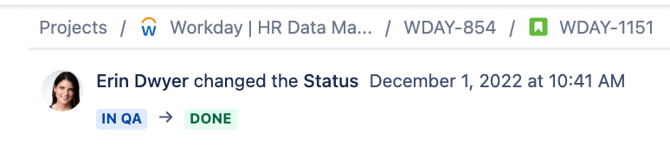
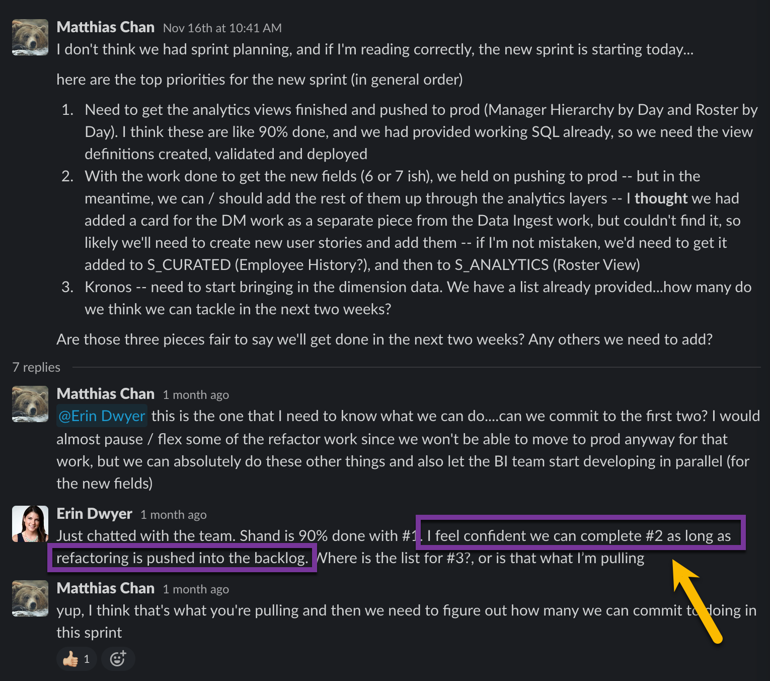
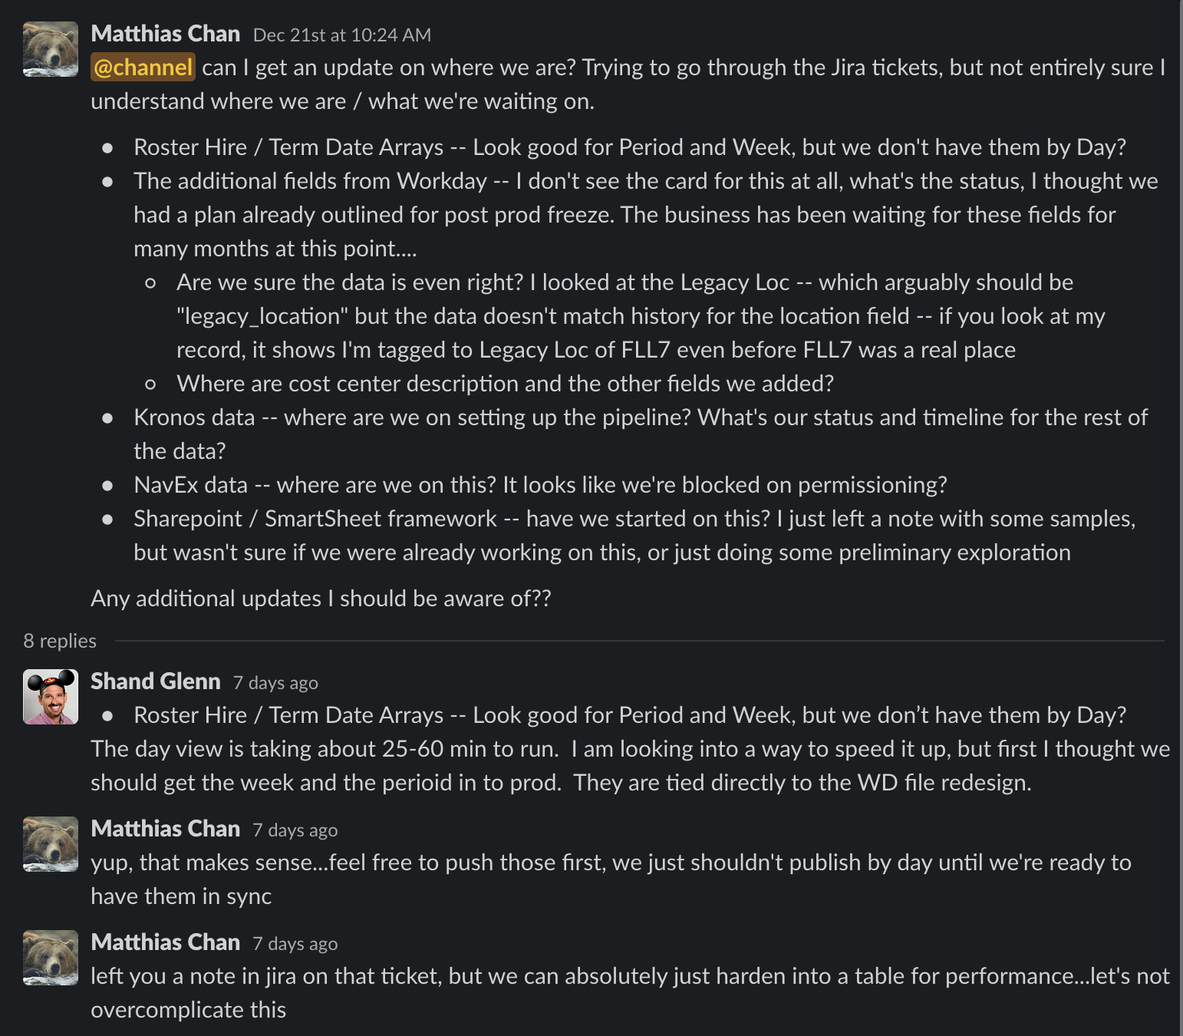
Example 0: Prioritization of Work
Added December 27, 2022
Background: We made the decision to NOT go to prod before Peak, but do the development so that we could push to production when Peak lifted on December 6th. This work was supposed to be done
I asked and prioritized on at least three separate occasions on the priority and asked for status updates….and the team committed to getting the data done in that sprint (Nov 16th)….I made VERY clear what the business was prioritizing at this time, and what the team had committed to delivering…
https://chewyinc.atlassian.net/browse/WDAY-1151

Slide 3
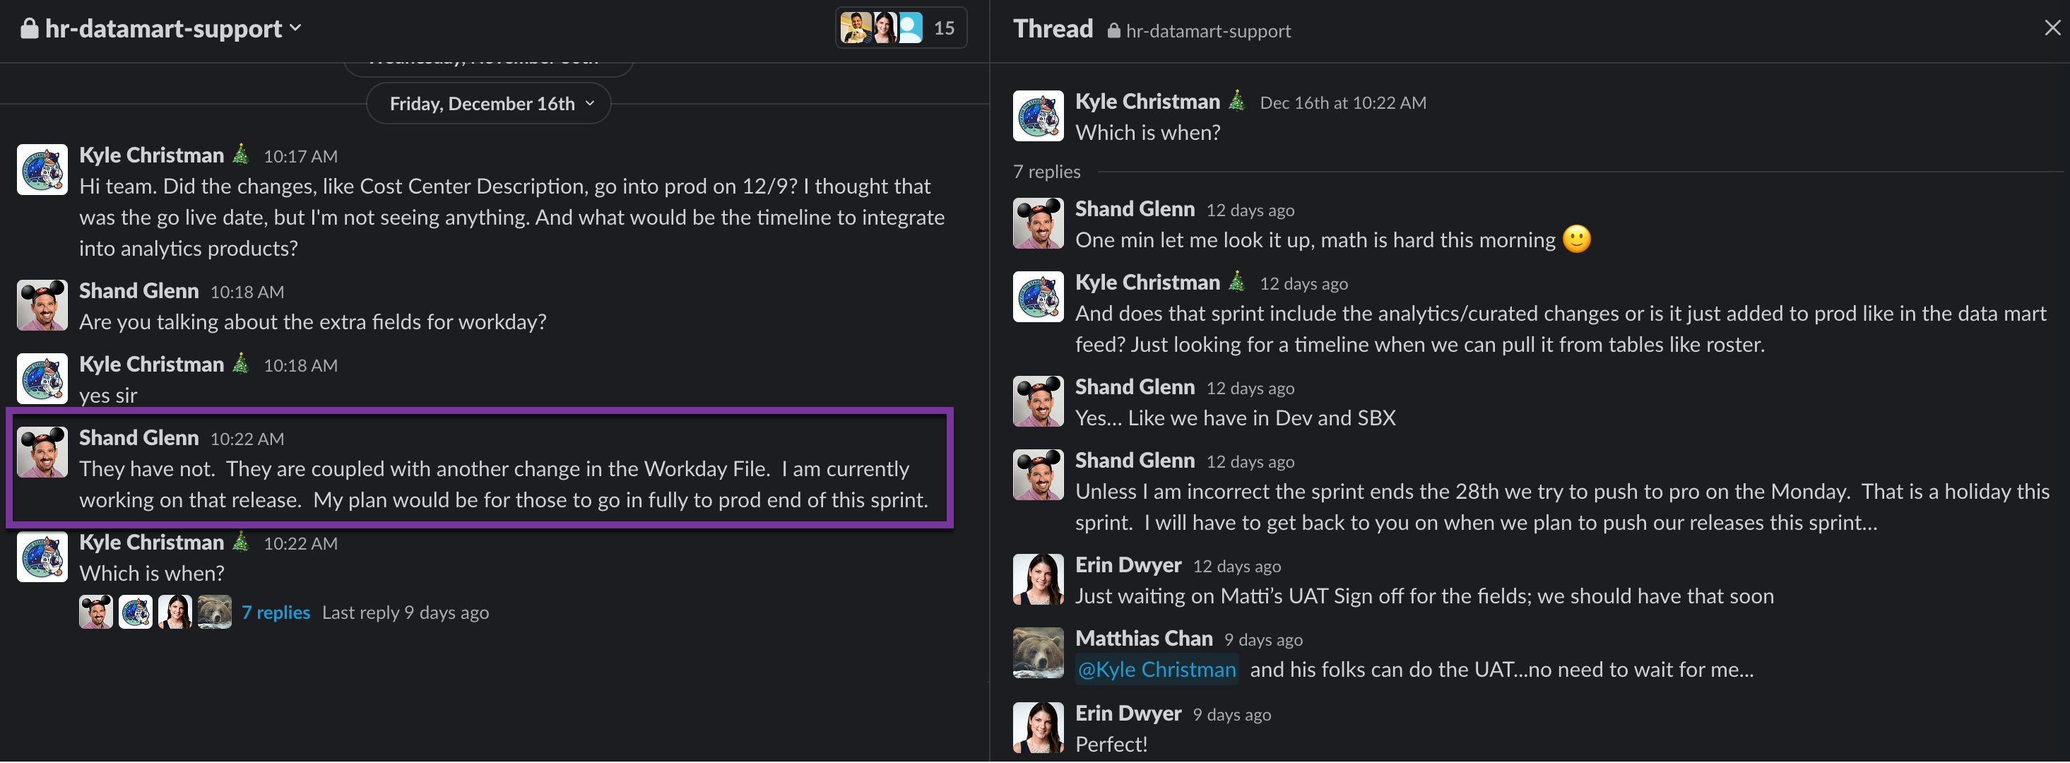
Example 0: Prioritization of Work
Added December 27, 2022
Background: When I came back on December 21st, I was surprised to find that we STILL weren’t in production yet.
In talking with the team, it turned out that somewhere along the way, the team had stopped working on adding the new fields (which was our top priority) and had restarted the work on the refactor work -- and had conflated the development of the two projects together…this change in prioritization is not documented anywhere (you won’t find it in JIRA), but apparently was done by direction from Kara
Since the 21st, we’ve reprioritized and are now pushing the fields to production this week.
Takeaway: Adding the fields was something that was not specifically prioritized by the business (until after the refactor) but was brought up as a parallel stop gap from the team. They committed to getting the dev work done in the November 16th sprint, and deploying to prod post peak on December 9th, but did not deliver to either of those dates.

Slide 4
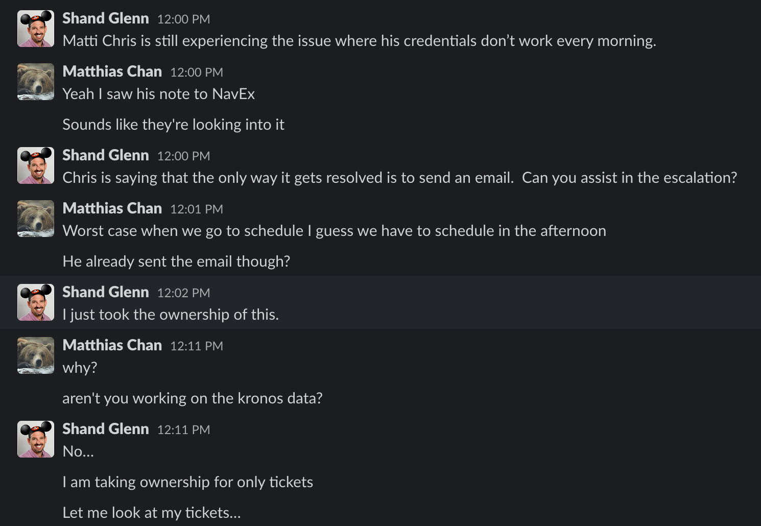
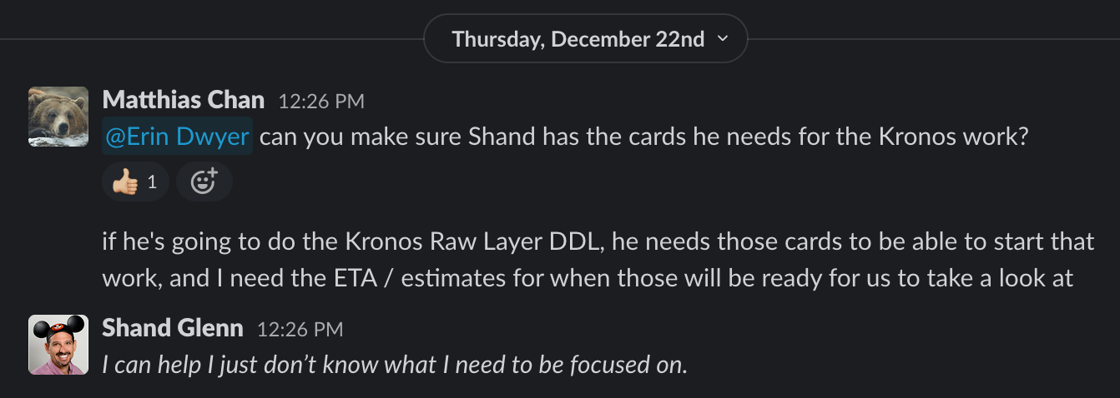
Example 0: Prioritization of Work
Added December 27, 2022
Furthermore, we have conversations in meetings to prioritize the work, and then the team still doesn’t know what they’re working on…the frustration is mounting all around, and that team needs some day to day leadership right now…especially with the vacuum created by Kara and Jim’s departures
Shand is having to step in and help with the contractors, but the sole reason we budgeted for and got contractors was to *free up* our developers to work on their tasks and not have to get pulled into all the technical details….
Who is managing the contractors now if Kara is gone?

Slide 5
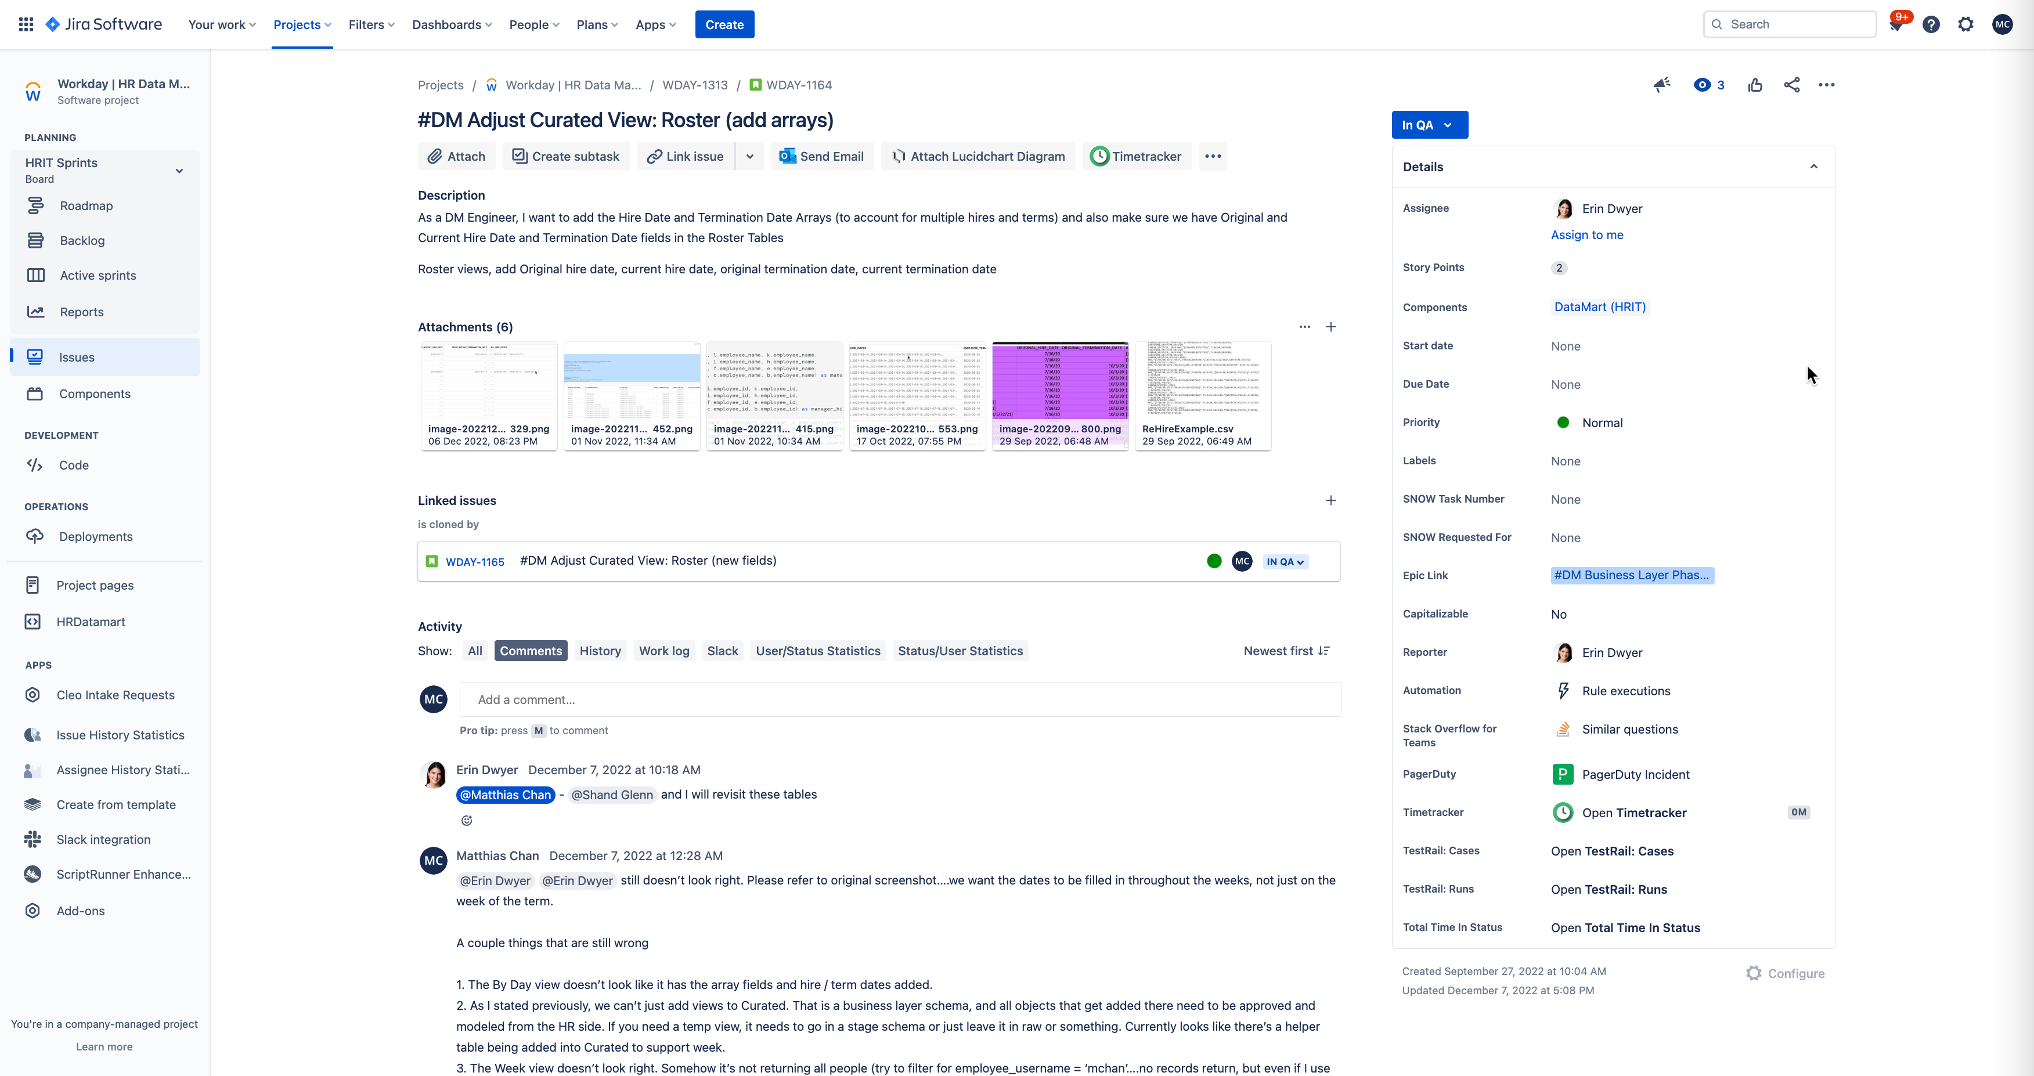
Example 1: Hire and Term Date Arrays
Created this user story on September 29th with exact requirements on what we want to see with an example
Story delivered on October 13th, but not even close to requirements. Sent back to team on October 19th.
No communication about it, I just happened to be on a call on Nov 1st, where they were discussing having issues with null values….I stepped in to give them some pointers on how to use Snowflake functions. Went as far as writing a piece of SQL to show them a working copy
No comms at all, and I had to reach out on Nov 11th to get a status update
Finally delivered on Nov 23rd, but data is still not correct. Still working on the data…this card to add 6 simple fields to a view has taken more than 2 months, and not in production (and I already gave them working code they could use)
https://chewyinc.atlassian.net/browse/WDAY-1164?atlOrigin=eyJpIjoiZDU1Zjc3YjIyMjE4NGExMmE4YTlhZDcyYzFhNWY4YTEiLCJwIjoiaiJ9

Slide 6
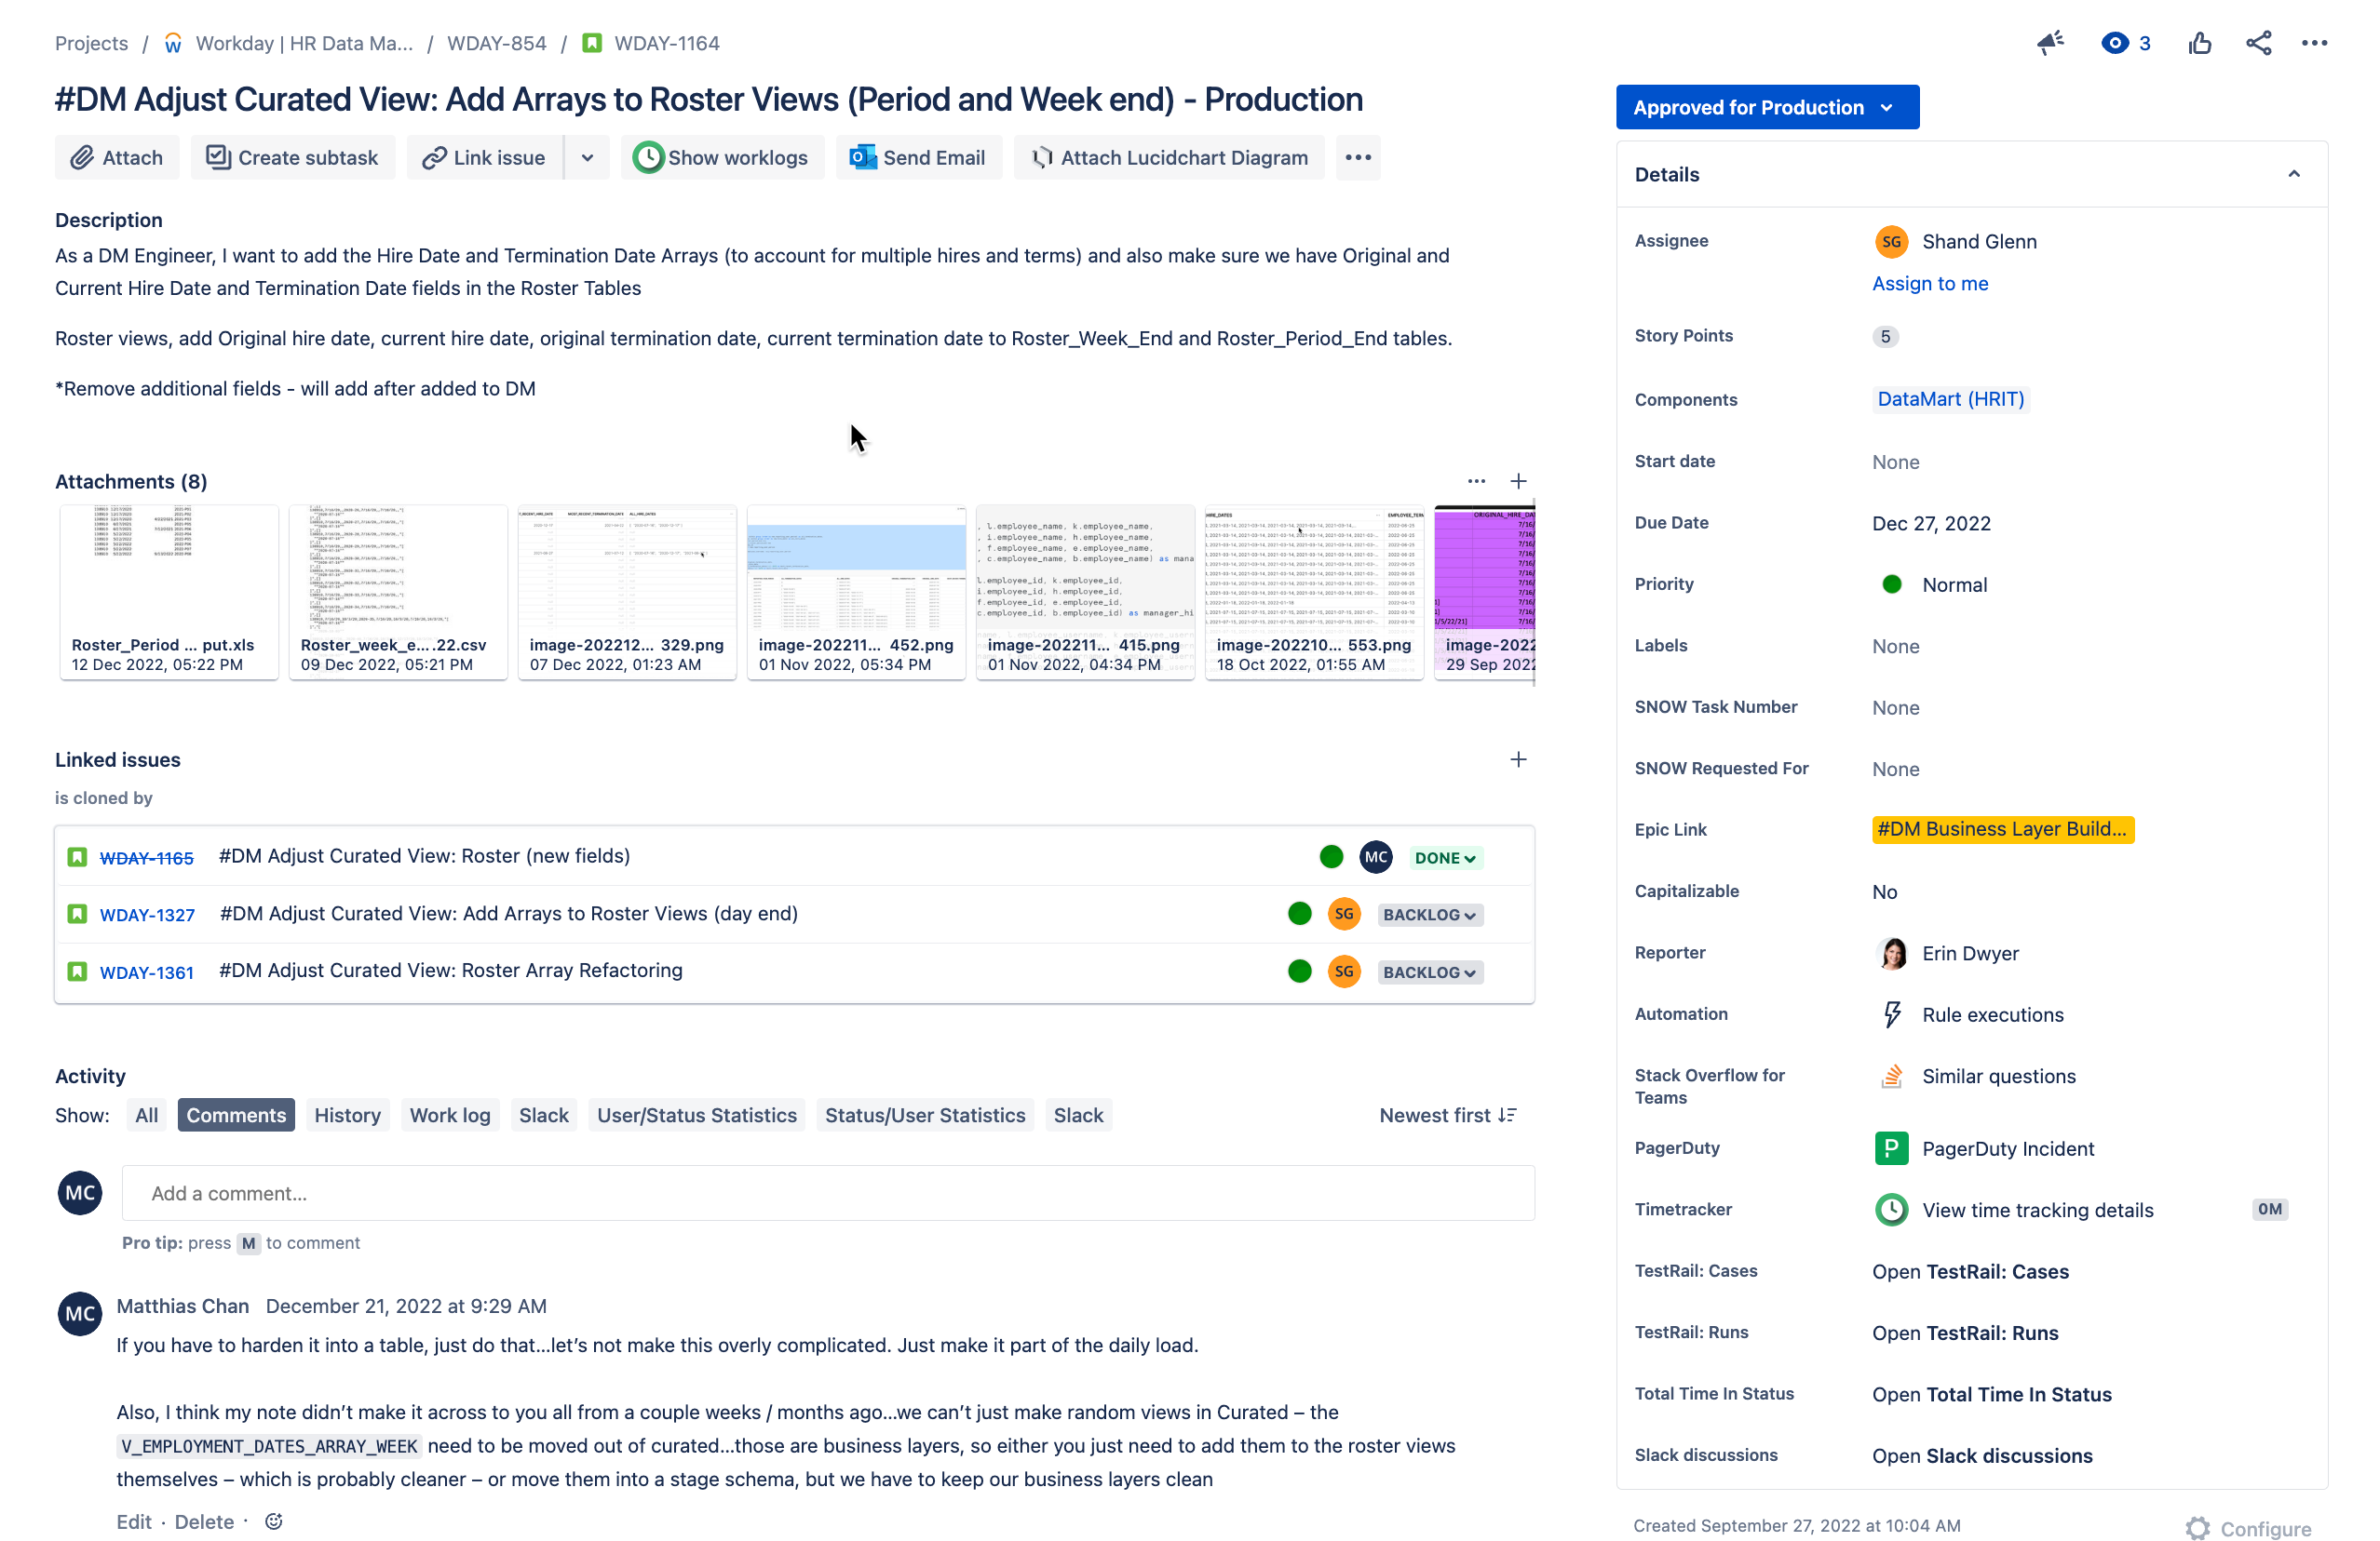
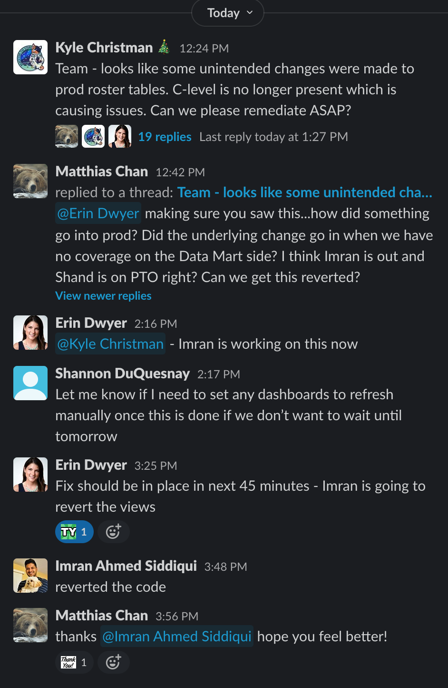
Example 1b: Hire and Term Date Arrays
Added December 27, 2022
Status still in “Approved for Production” on December 27th, 2022, but deploy happened on December 23rd, 2022
Deployed on December 23rd, 2022, but while the new fields are correct, it seems they were added to an old view, so they dropped fields that were added in a deploy in October. Those couple fields are mission critical fields, and caused Production Impacts to critical reports
No notes or deployment notes in the Jira (although email sent alerting about the deployment up front, no status about the deployment or any updates on whether it was done, etc were tracked)
Production Reports were impacted and were down from Friday to Monday at 3:46PM (nearly 3.5 hours after reporting the issue). We had to call in Imran who reverted back even though he was out sick.
I asked several times last week whether we were sure we wanted to do a deploy around a holiday, and definitely should not have rushed something into production. We need to deliver, but more importantly, we need to deliver working and accurate products.

Slide 7
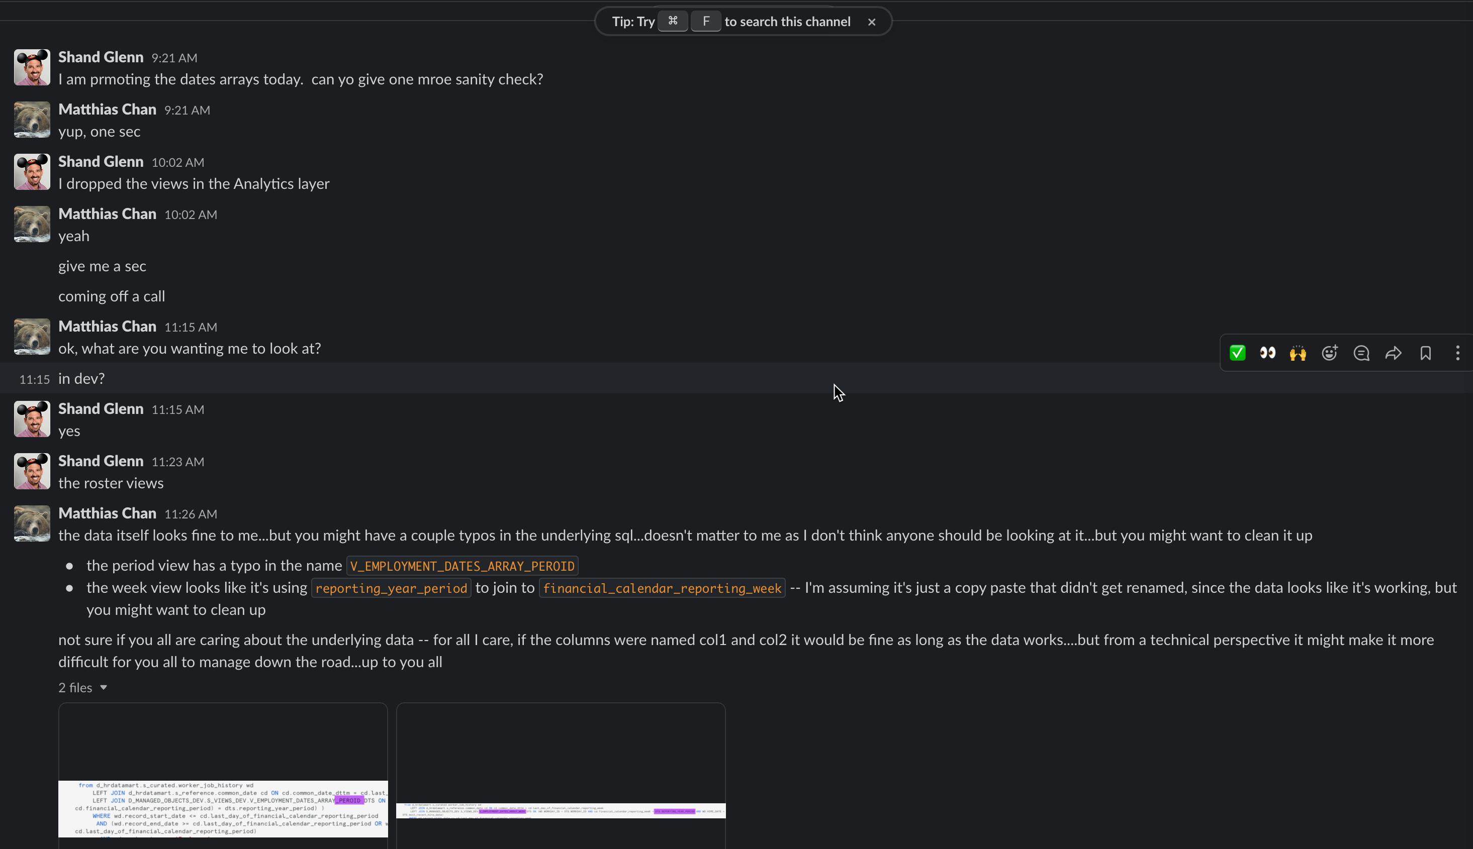
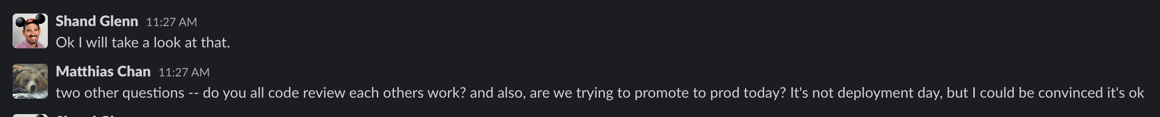
Example 1c: Hire and Term Date Arrays
Added December 27, 2022
I was concerned that this would happen, and flagged it, but didn’t get a response…on December 22nd, 2022 (day before deploy), I was pinged to “check” the data once again. I looked into the data for the arrays, but assumed that the other fields had been regression tested already by the developers….
I also asked whether they were code reviewing each other’s code, because I shouldn’t have to look at the underlying code for the Raw / Storage Layers, but I happened to take a look, and noticed a bunch of typos and oddities (one of which still didn’t get fixed and is was promoted to production now).
https://chewyinc.atlassian.net/browse/WDAY-1164?atlOrigin=eyJpIjoiZDU1Zjc3YjIyMjE4NGExMmE4YTlhZDcyYzFhNWY4YTEiLCJwIjoiaiJ9

Slide 8
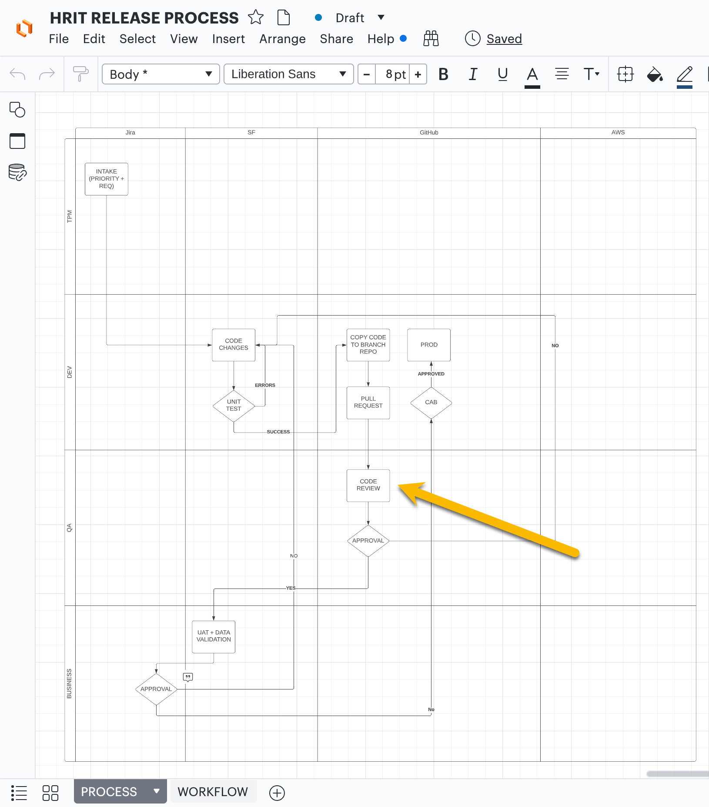
Example 1c: Hire and Term Date Arrays
Added December 27, 2022
Looks like we’re skipping a couple steps within Dev to do any code reviews, and not following our own processes…

Slide 9
Example 2: Adding Dates Dimensions to the Calendar Table
Initial Ask sent over September 15th to review, but didn’t have permissions set correctly, so users couldn’t even test. Took 2 Weeks to set the permissions.
Initial Ask
https://chewyinc.atlassian.net/browse/WDAY-809
Once we got into the data, it was clearly incorrect. Columns mapped incorrectly, clearly not right. No communication over JIRA, and developers needed to ping me directly. To get the data into production because we had waited over a month already, we pushed what was there to prod, and then created a follow up card to add the rest of the fields.
Follow up
https://chewyinc.atlassian.net/browse/WDAY-1171
New follow up card, mysteriously went into the “Done” status yesterday (December 7th) with no comms, and no delivery to UAT for any users to test. No idea what the status is on this, whether they pushed it to prod inadvertently or anything like that.

Slide 10
Example 3: Workday fields missed in initial Workday setup
We did a gap analysis to identify fields that were missing from our feed from Workday. The team was supposed to identify and add all those fields. The initial card, was created, there’s no comms for 2 months, and then all of a sudden we get a notification that the fields are added without any context. Have to dig to find the actual fields.
First card to add fields from Workday
https://chewyinc.atlassian.net/browse/WDAY-698
We missed several fields that were still needed so another card was added September 22. I’ve asked multiple questions in the JIRA card (see WDAY-1151), but no responses whatsoever, have to ping the on slack to get any sort of update.
Initial Card to add fields to Workday feed (Integrations Side)
https://chewyinc.atlassian.net/browse/WDAY-1151
I had to ask / remind the team about the second table (the top of stack table), even though I shouldn’t really know or care about that table…but they need to keep them in sync. Still not sure there’s a new User Story accounting for that work.
Add fields to the Data Mart (Raw Layer)
https://chewyinc.atlassian.net/browse/WDAY-1270
I was told that this card was blocked by the Trended View timeout, and then all of a sudden it was being worked on, because the Freeze was coming up, and we tried to sneak the card into Production (which likely would have had production impacts)
Add fields to the Data Mart (Curated / Product Layer)
https://chewyinc.atlassian.net/browse/WDAY-1294
If you look at WDAY-1270. The data was sent over to me, and the data was clearly still wrong. Had to send back over for re-work again. Wasting my time, and wasting the EPA teams time (and trust in the data) because everytime they look at something that’s being “delivered” in dev, it seems like columns are mismatched, or just wrong.

Slide 11
Example 3: Workday fields missed in initial Workday setup (Continued)
If you look at WDAY-1270. The data was sent over to me, and the data was clearly still wrong. Had to send back over for re-work again. Wasting my time, and wasting the EPA teams time (and trust in the data) because everytime they look at something that’s being “delivered” in dev, it seems like columns are mismatched, or just wrong.
First card to add fields from Workday
https://chewyinc.atlassian.net/browse/WDAY-698
Initial Card to add fields to Workday feed (Integrations Side)
If you look at WDAY-1270, they are still not leaving comments in the JIRA tickets…it’s only Erin (trying) to pass along information. People are just not working out of the JIRAs like a normal Sprint team.
https://chewyinc.atlassian.net/browse/WDAY-1151
Add fields to the Data Mart (Raw Layer)
If you look at WDAY-1294, the product and curated layers are now in QA (over to Erin) but there’s no information about what is delivered, where it’s delivered, etc. No comms whatsoever
https://chewyinc.atlassian.net/browse/WDAY-1270
Add fields to the Data Mart (Curated / Product Layer)
https://chewyinc.atlassian.net/browse/WDAY-1294

Slide 12
Example 4: Lack of movement for data products delivered to the EPA team for additional insights and analytics
We haven’t deployed anything to production of business value since October 4th. There have been no new data elements or products that have been built through to production. That’s over two months of “waiting” from the business side on any sort of movement
A couple different reasons for this…
Working on technical updates (SSO, Development Pipelines, Refactor of Workday feed because of timeouts / non-scalability)
Incorrect development of analytics products (see the previously slides)
Lack of resources from the integration side to both deliver Workday Integrations to other vendor products and also to the Data Mart (clash in resources)

Slide 13
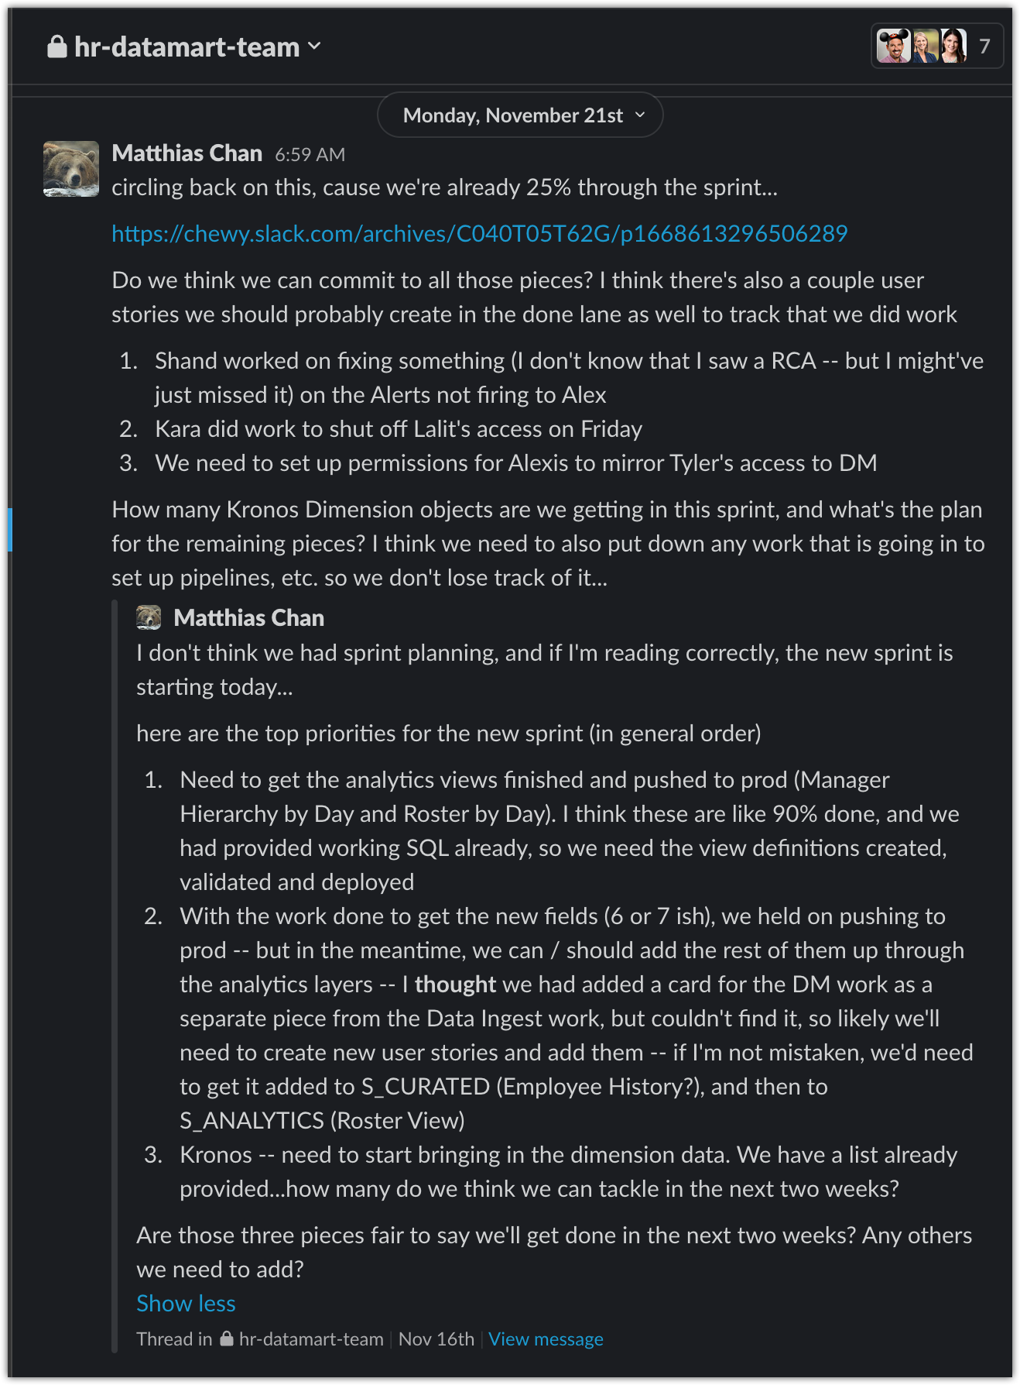
Example 5: Lack of communication in JIRA
I stopped created JIRA tickets, because the ones I was creating kept getting lost. I now just let Erin know what is being asked for, and let her manage JIRA completely.
To supplement, we added two slack channels for stakeholder engagement (hr-datamart-support) and for internal team comms (hr-datamart-team).
In the team slack channel, the team does not respond or get any sort of response back to me / stakeholders. Last sprint, I asked for what things we could commit to from a Data Mart team, and I got no response, and none of the three things I mentioned as top priorities got delivered.
I still do not know what Kronos objects are being worked on at this time, nor do I know what ETA to expect for those objects.
At this point, I have no confidence in a sprint, nor do I commit any sort of timelines to my stakeholders, because this team does not deliver in any sort of standard cadence, nor do they meet timelines.

Slide 14
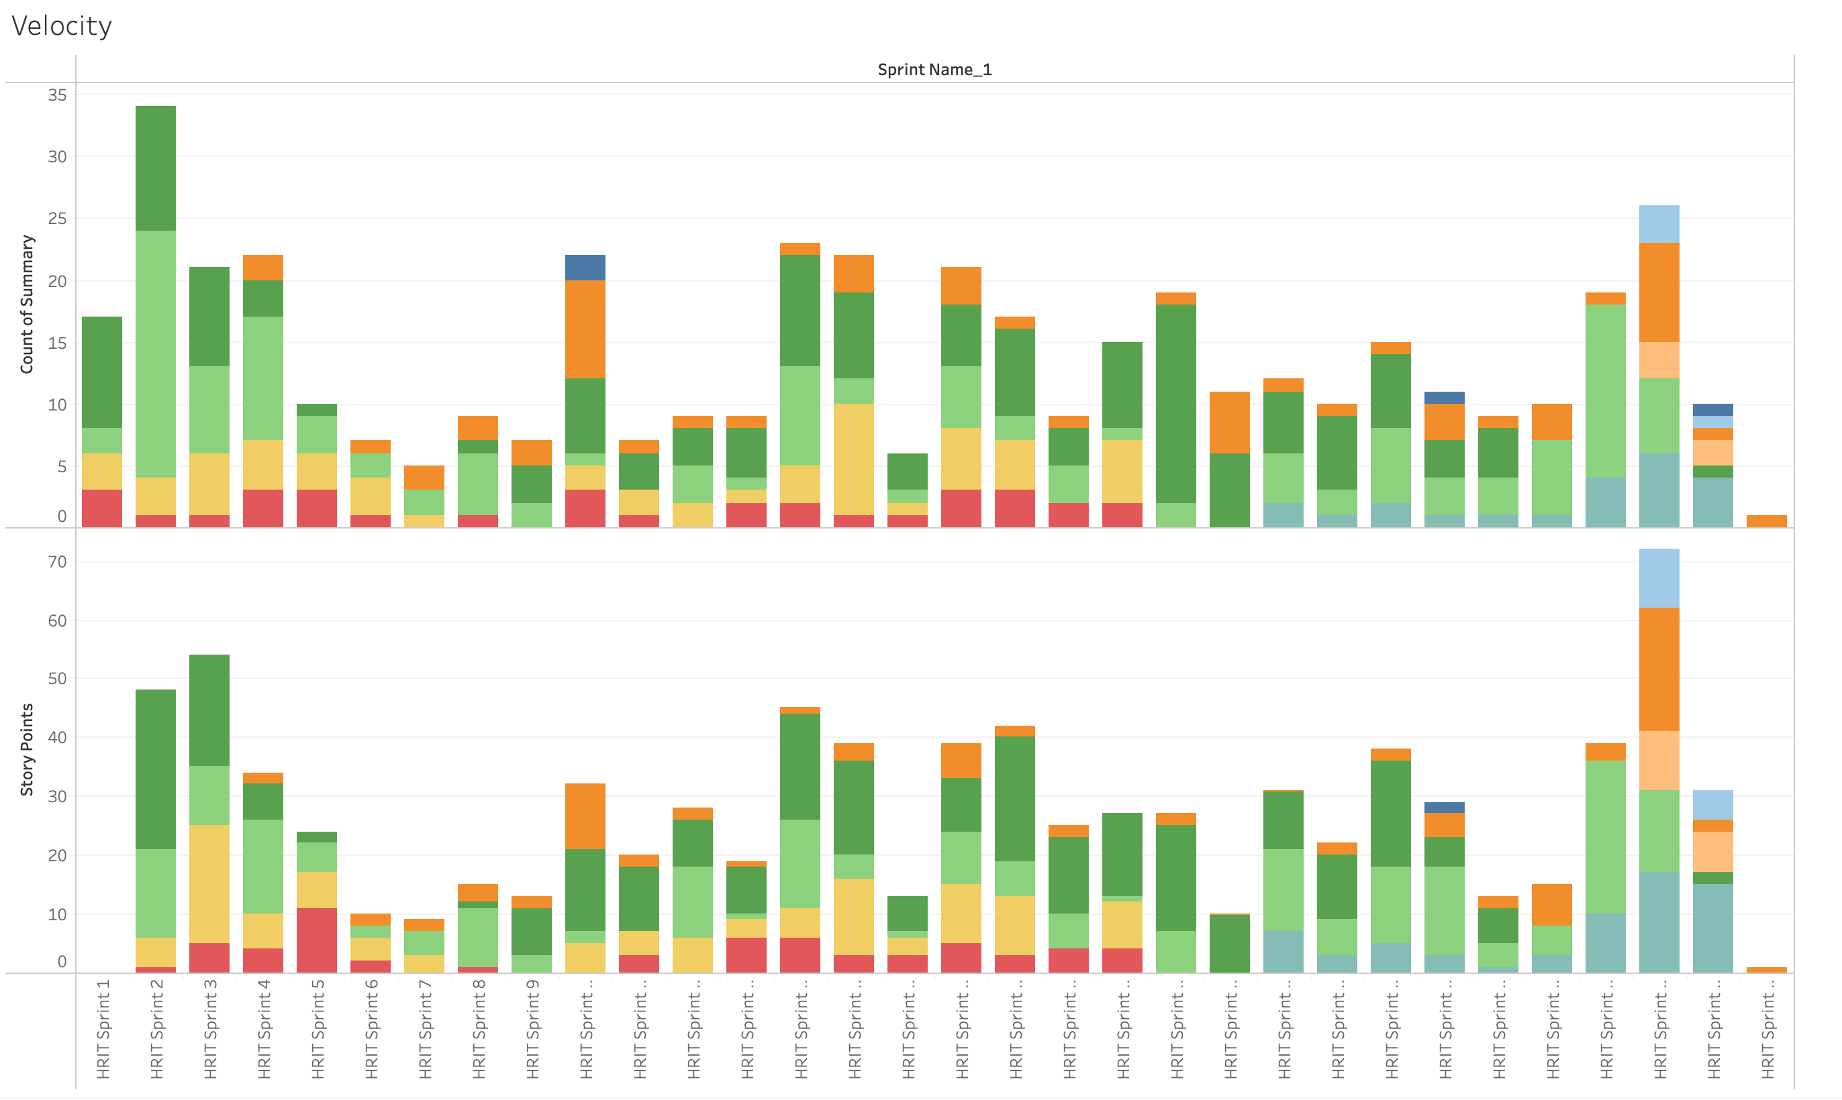
Example 6: JIRA Stats - Velocity
No consistency in terms of velocity
Most of these stories are technical back end (lately, and don’t have immediate business impact or value) – We need to do these for scalability, but we also aren’t delivering new business value right now

Slide 15
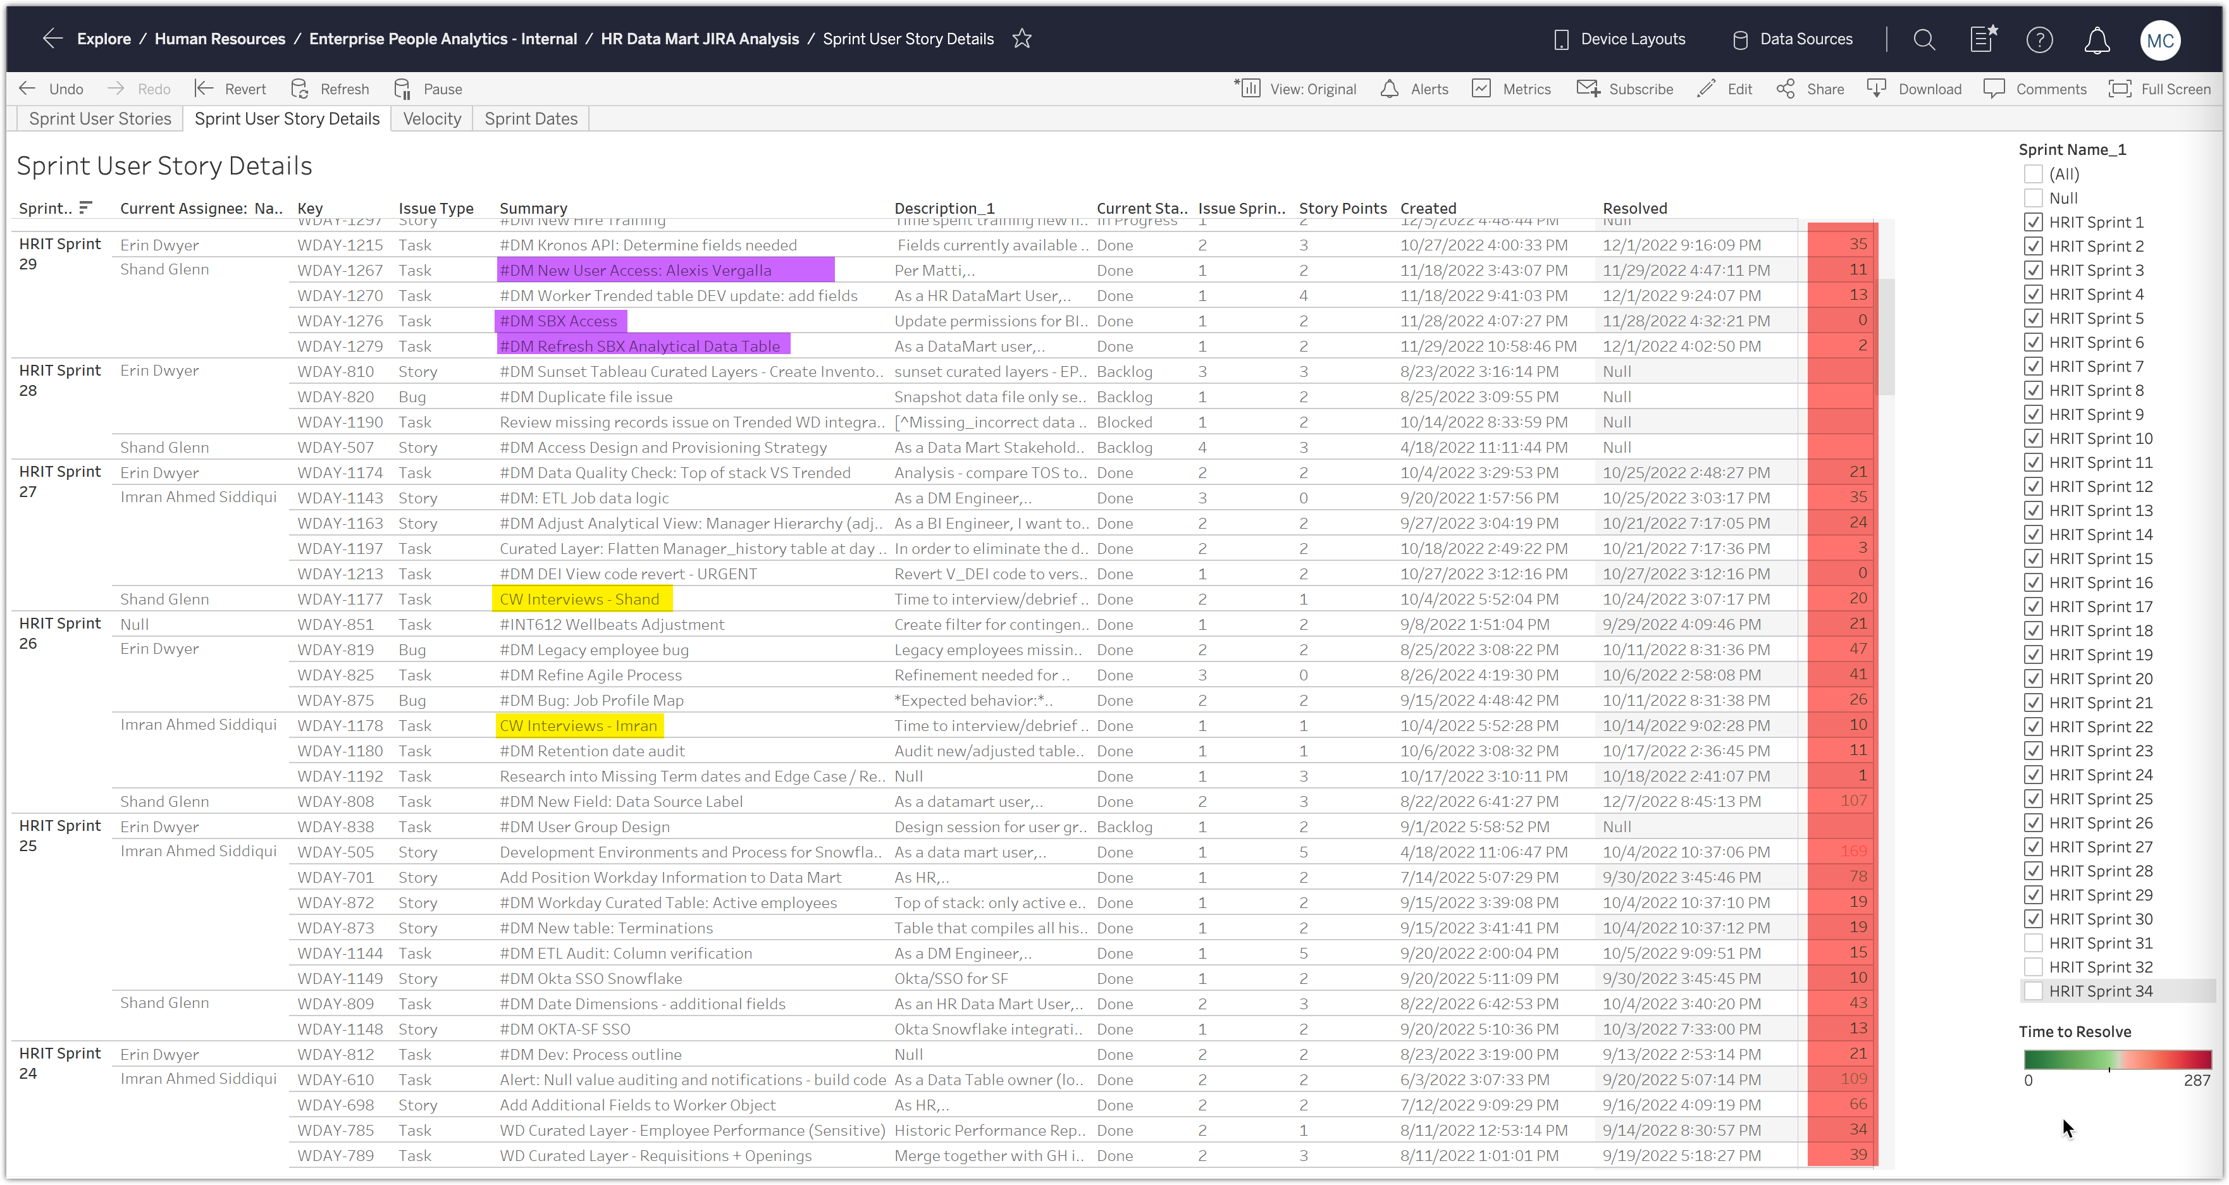
Example 7: JIRA Stats – User Story Analysis
Looking at the last 6 sprints (and even more…just showing 6 on the screenshot), it looks like we haven’t delivered anything in quite awhile. Purple ones are just admin tasks – setting permissions. Yellow ones are Interviews for the CWs
Furthermore, if you look at the average time to resolve, those issues have some astounding # of days to completion. It routinely takes us months for things to get done, and multiple sprints for each story
Given the state of the team, I can’t even really use the metrics to project out with any confidence what the team will actually be able to deliver going forward. I’ve just been trying to prioritize and wait – much more waterfall at this point rather than agile…

